Slide 1
PSG COLLEGE OF TECHNOLOGY
DEPARTMENT OF INSTRUMENTATION AND CONTROL SYSTEMS ENGINEERING
15U820 – PROJECT WORK II
MICROCONTROLLER BASED SMART HELMET FOR COAL MINER’S SAFETY
Project by
DHIVYABHARATHI C(17U211)
DIVIYA BHARATHI M(17U212)
RAMYA S(17U243)
Guided by
Ms. J SONYA,
Assistant Professor

Slide 2
OVERVIEW
Problem Statement
Objective
Need for current study
Literature survey
Block diagram
Software implementation
Sensor specifications
Future Scope
Timeline of the project
References

Slide 3
PROBLEM STATEMENT
Generally miner’s safety is most important issue in mining industry. Every year, thousand of miners die and get injured. The main reasons for those accident are due to the presence of dangerous gases, high temperature and abnormal humidity conditions.
Thus we have designed a smart helmet for coal miner’s which ensure the safety of the workers who engaged in the mining activity in the coal mines.

Slide 4
OBJECTIVE
The objective of this project is to design a smart helmet for coal miner’s which will help the workers in abnormal condition by producing an alarm.

Slide 5
NEED FOR CURRENT STUDY
To monitor the several environmental conditions inside the mines and intimate the miners’ in case of any emergency.
Assuring miners’ safety in case of any mining accidents by detecting the poisonous gases present in the mines.

Slide 6

Literature survey
RESEARCH PAPER | METHODOLOGY USED
T.Pathan, Puja G. Panchbuddhe, “Microcontroller based Smart Helmet for Coal Miners Safety”, International Journal for Research in Applied Science and Engineering Technology, Vol.06, Issue No.IV, Apr 2018. | This paper tends to develop a wireless sensor network to monitor real time situation of underground mines from base station. It gives surveillance with early warning intelligence.
Puja G. Panchbuddhe, Assistant Prof. T. Pathan, “A Microcontroller based smart helmet for coal miners for air quality and hazardous event detection”, The Journal of the Southern African Institute of Mining and Metallurgy, Vol.04, Issue No. 03, Feb 2018. | In this system, data is transmitted wirelessly through RF module which can support multiple baud rate and range of the system is also high.

Slide 7
Contd…
RESEARCH PAPER | METHODOLOGY USED
S.R.Deokar, V.M.Kulkarni, J.S.Wakode, “Smart Helmet for Coal Mines Safety Monitoring and Alerting”, International Journal of Advanced Research in Computer and Communication Engineering, Vol.06, Issue No.07, Jul 2017. | This system uses Zigbee technology for transmission of data from underground miners to base station. It also provides real time monitoring of harmful gases like CO, CH4 and LPG and also temperature.
A.Dhanalakshmi, P.Lathapriya, K.Divya, “A Smart Helmet for improving safety in mining industry”, International Journal of Innovative Science and Research Technology, Vol.02, Issue No.03, Mar 2017. | A smart helmet has been developed with various features such as two way communication and also GPS technology is provided to track the location of the miners.

Slide 8
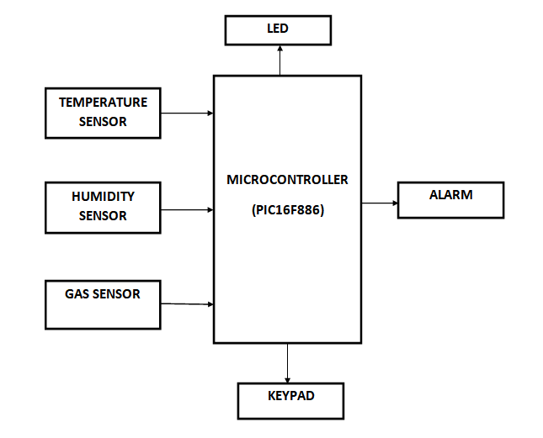
BLOCK DIAGRAM
Figure 1: Block diagram^{[1]}

Slide 9
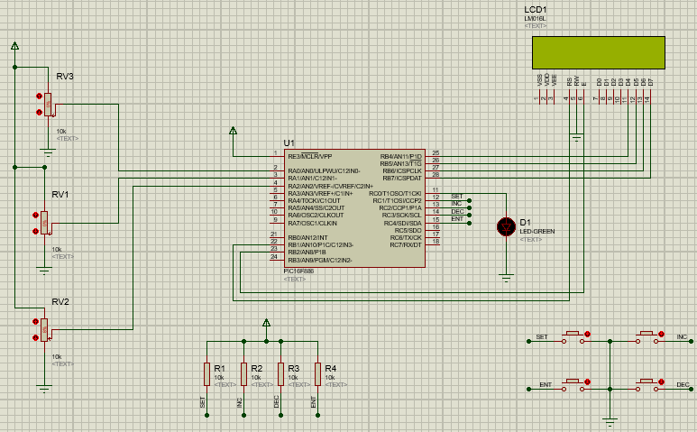
SOFTWARE IMPLEMENTATION
Microcontroller(PIC16F886)
Gas sensor
Temperature sensor
Buzzer(LED)
Humidity sensor
Switch(Keypad)
Figure2: Circuit diagram in PROTEUS

Slide 10
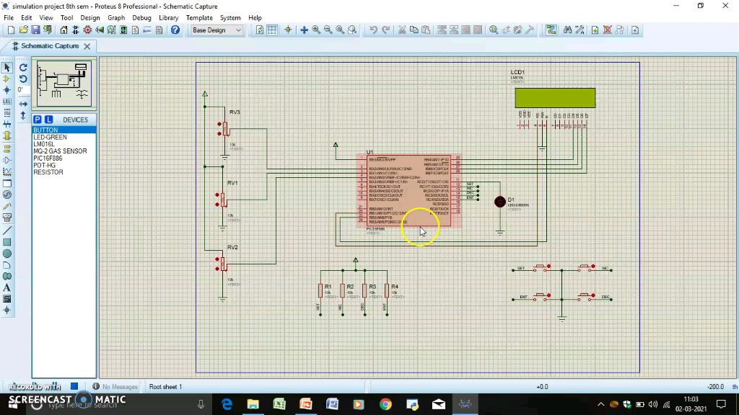
VIDEO

Slide 11
Contd....
Initially the program is dumped into the microcontroller and the preset value of temperature, gas and humidity is entered.
The values of these parameters can be varied using a potentiometer in the proteus software.
Whenever the changed values exceed the preset value then an alarm signal will arise which is indicated by the led light

Slide 12
SENSOR SPECIFICATIONS
MEASURING PARAMETERS | NAME OF THE SENSORS | SPECIFICATIONS
Temperature | LM35 sensor | Operating temperature range: -55ºC to 150ºC
Gas (CH4, CO, LPG) | MQ4, MQ7, MQ5 sensors | For MQ5: Operating Voltage: 5.1V Sensing resistance: 10-60kΩ Detecting concentration: 200-10,000ppm
Humidity | DHT11 sensor | Operating voltage: 3.5-5.5V Humidity range: 20-90% Accuracy: ±1%

Slide 13
FUTURE SCOPE
The system can be improved by adding more measuring devices to check miner’s blood pressure and heart rate also.
To update GPS location and sensor data which enables easy tracking and providing oxygen supplements when necessary.
The database can also be created which monitors the sensor modules continuously.

Slide 14
TIMELINE OF THE PROJECT
MONTH | WORK
January | Topic identification Literature survey
February | Selection of hardware components Software simulation
March | Hardware implementation Project report work

Slide 15
REFERENCES
T.Pathan, Puja G. Panchbuddhe, “Microcontroller based Smart Helmet for Coal Miners Safety”, International Journal for Research in Applied Science and Engineering Technology, Vol.06, Issue No.IV, Apr 2018.
Puja G. Panchbuddhe, Assistant Prof. T. Pathan, “A Microcontroller based smart helmet for coal miners for air quality and hazardous event detection”, The Journal of the Southern African Institute of Mining and Metallurgy, Vol.04, Issue No.3, Feb 2018.
S.R.Deokar, V.M.Kulkarni, J.S.Wakode, “Smart Helmet for Coal Mines Safety Monitoring and Alerting”, International Journal of Advanced Research in Computer and Communication Engineering, Vol.06, Issue No.7, Jul 2017.
A.Dhanalakshmi, P.Lathapriya, K.Divya, “A Smart Helmet for improving safety in mining industry”, International Journal of Innovative Science and Research Technology, Vol.02, Issue No.3, Mar 2017.
Sunil E.Waghmare, Ashish Manusmare, Prof. Vijay Roy, “Microcontroller based Smart Helmet for Coal Miners Safety”, International Journal of Science, Engineering and Technology Research, Vol.06, Issue No.8, Aug 2017.

Slide 16
THANK YOU

